Slide 1
DSTG Planet Gear Rim Fatigue Crack Propagation Test
Dr. David Blunt and Dr. Wenyi Wang, Lucinda Le Bas, Riyazal Hussein, Peter Stanhope
George Jung, Elizabeth Hinchey, Eric Lee, Greg Surtees, Nicholas Athiniotis and Scott Moss
Platforms Division, DSTG, Australia

Slide 2
Outline
Purpose
Test article and process
Gearbox layout & sensors
Online monitoring
HUMS 2023 data challenge dataset
Fractography analysis
Conclusion
OFFICIAL – Approved for Public Release

Slide 3
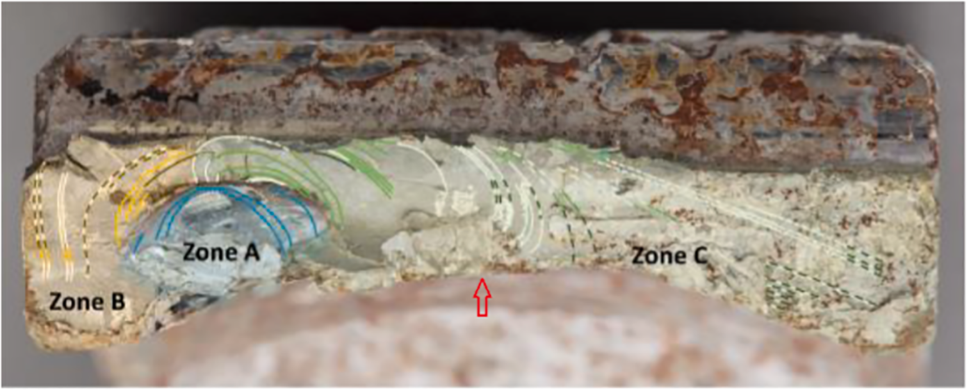
1. Purpose
To explore the phenomenon of fatigue cracking in thin-rim helicopter planet gears
Crack initiates at or near the raceway surface and propagates through the gear body
Can lead to the catastrophic failure of the main rotor gearbox
Challenging to detect reliably, so we conducted a controlled test & generated an extensive dataset
Detectable at halfway?
EC 225 LP planet gear rim crack propagation [Fig. 31 from AIBN Report SL 2018/04]
OFFICIAL – Approved for Public Release

Slide 4
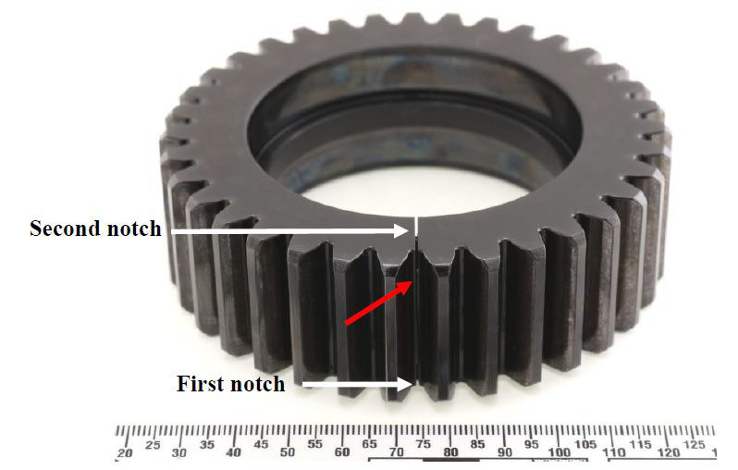
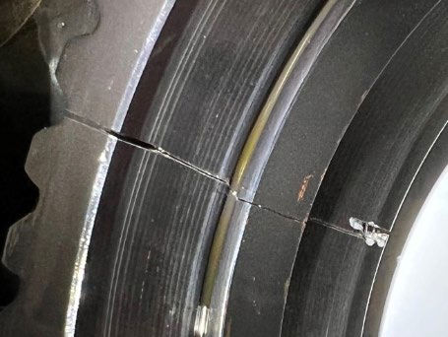
2. Test article and process
Bell Kiowa 206B-1 (OH-58) main rotor gearbox (four-planet version).
The test was run in the Helicopter Transmission Test Facility (HTTF) at DSTG – Melbourne
1st notch 06/2020 – 12/2020
2nd notch 10/2021 – 01/2022
OFFICIAL – Approved for Public Release

Slide 5
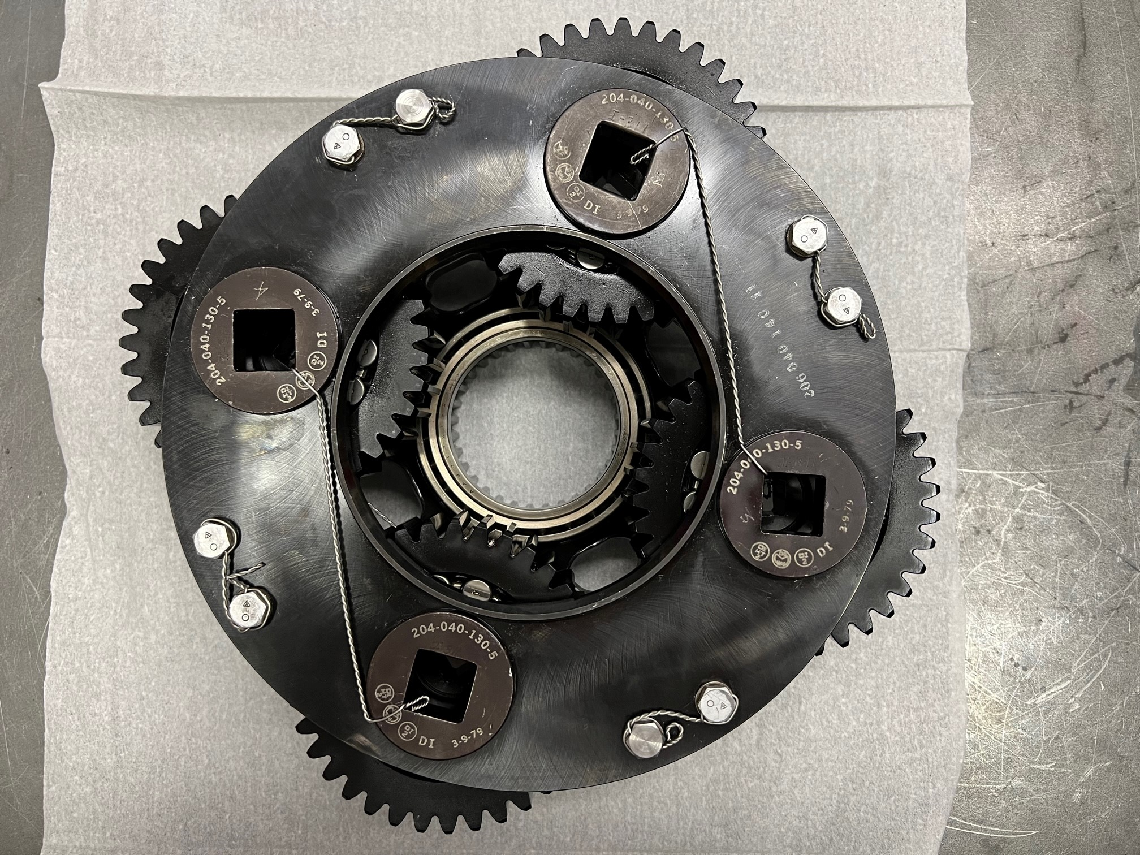
2. Planet Carrier
Planets diametrically opposite
Non-uniform spacing (88.6°, 91.4°)
Mesh 180°out of phase for opposite planets
Odd-orders sum to zero for opposite pairs
Even-orders in phase for opposite planets – but different phase between planet pairs
Notch
OFFICIAL – Approved for Public Release

Slide 6
2. Data acquisition & load cycle
18-channel B&K LAN-XI system (4x tach, 7x vib, TQ, oil T&P, load)
National Instruments PXI-6259 system for online monitoring (1x tach, 4 vib, TQ)
Matlab GUI to monitor the test in near real-time (~10 sec process time)
Gastops MetalSCAN (Model 2201) inductive wear debris monitor
# | Load | Input Torque (Nm) | Input speed | Duration (cycles 1-9) | Duration (cycles 10-241)
A | 50% | 152 | 6000 RPM | 3 minutes | 2 minutes
B | 75% | 227 | 6000 RPM | 3 minutes | 2 minutes
C | 100% | 303 | 6000 RPM | 3 minutes | 2 minutes
D | 125% | 379 | 6000 RPM | 21 minutes | 24 minutes
OFFICIAL – Approved for Public Release
Notes:
Fs = 65536 Hz

Slide 7
3. Gearbox layout & sensors
Sensor Description
IP-1 Input pinion flange
RF-2 Front of the gearbox (upper housing flange near ring gear)
RL-3 Left side of the gearbox (upper housing flange near ring gear)
RR-4 Rear of the gearbox (upper housing flange near ring gear)
Bell 206B-1 (OH-58) main rotor gearbox (three-planet version). The four-planet version was used in the test.
OFFICIAL – Approved for Public Release

Slide 8
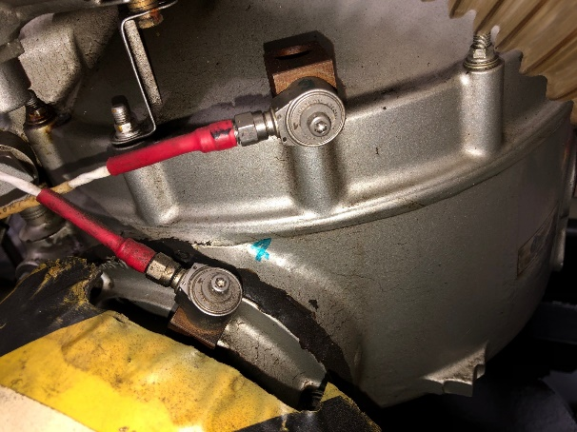
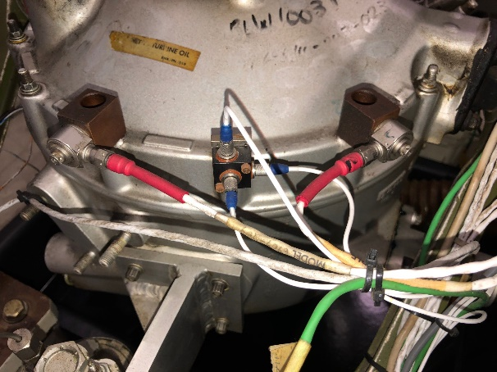
3. Accelerometers mounted on gearbox
Accelerometers IP-1 & RR-4
Accelerometers RF-2 & RL-3
OFFICIAL – Approved for Public Release

Slide 9
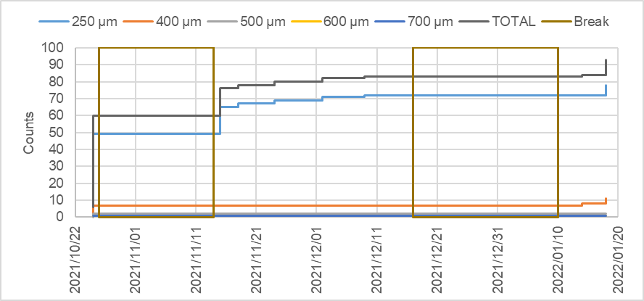
4. Real Time Monitoring – ferromagnetic wear debris
After gearbox reassembly
Cracked through
Test break
Test break
OFFICIAL – Approved for Public Release

Slide 10
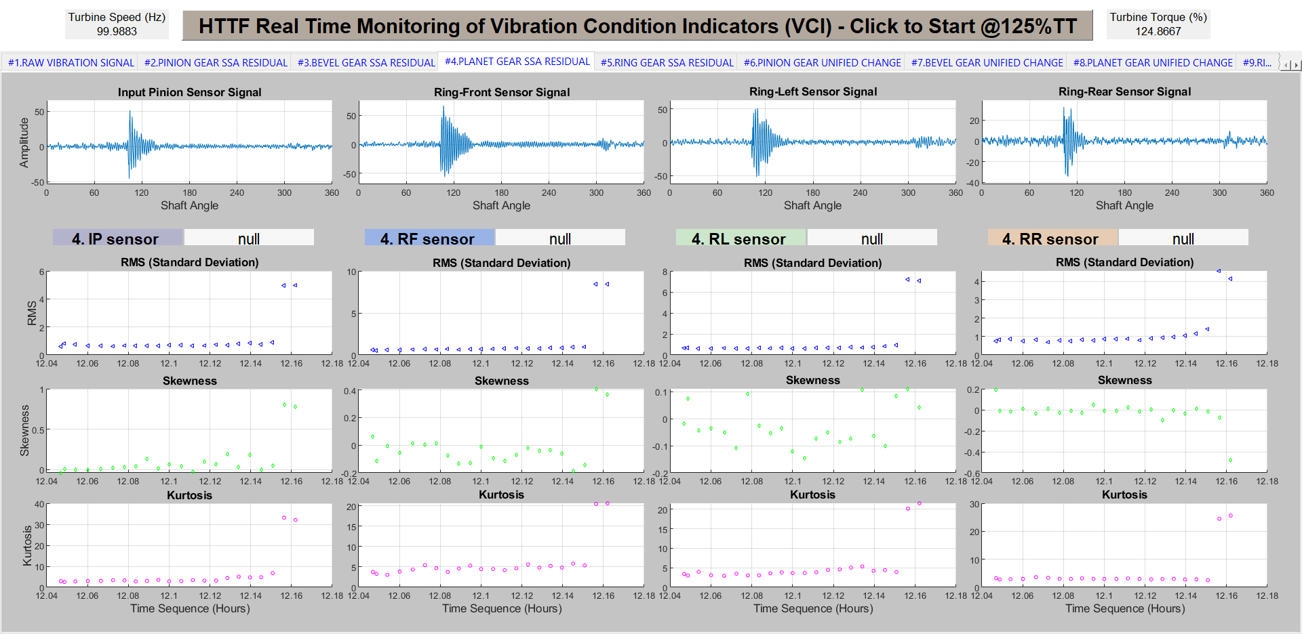
4. Real-time monitoring – vibration analysis at the last cycle
OFFICIAL – Approved for Public Release

Slide 11
4. Health monitoring – offline vibration analysis (Day021~027)
Detail in next slide
VCI8 & VCI9 = low & full band scaled kurtosis of change signals; Shaft(3) = planet gear shaft
OFFICIAL – Approved for Public Release

Slide 12
4. Health monitoring – offline vibration analysis
OFFICIAL – Approved for Public Release

Slide 13
5. HUMS2023 data challenge dataset – Oil temperature
Temperature may have affected the on-line trending
Main reason why HUMS Data Challenge data starts at Day 21 = 8 Dec 2021
OFFICIAL – Approved for Public Release

Slide 14
5. HUMS2023 data challenge dataset – Torque load variation
OFFICIAL – Approved for Public Release

Slide 15
5. HUMS2023 data challenge dataset – speed variations
OFFICIAL – Approved for Public Release

Slide 16
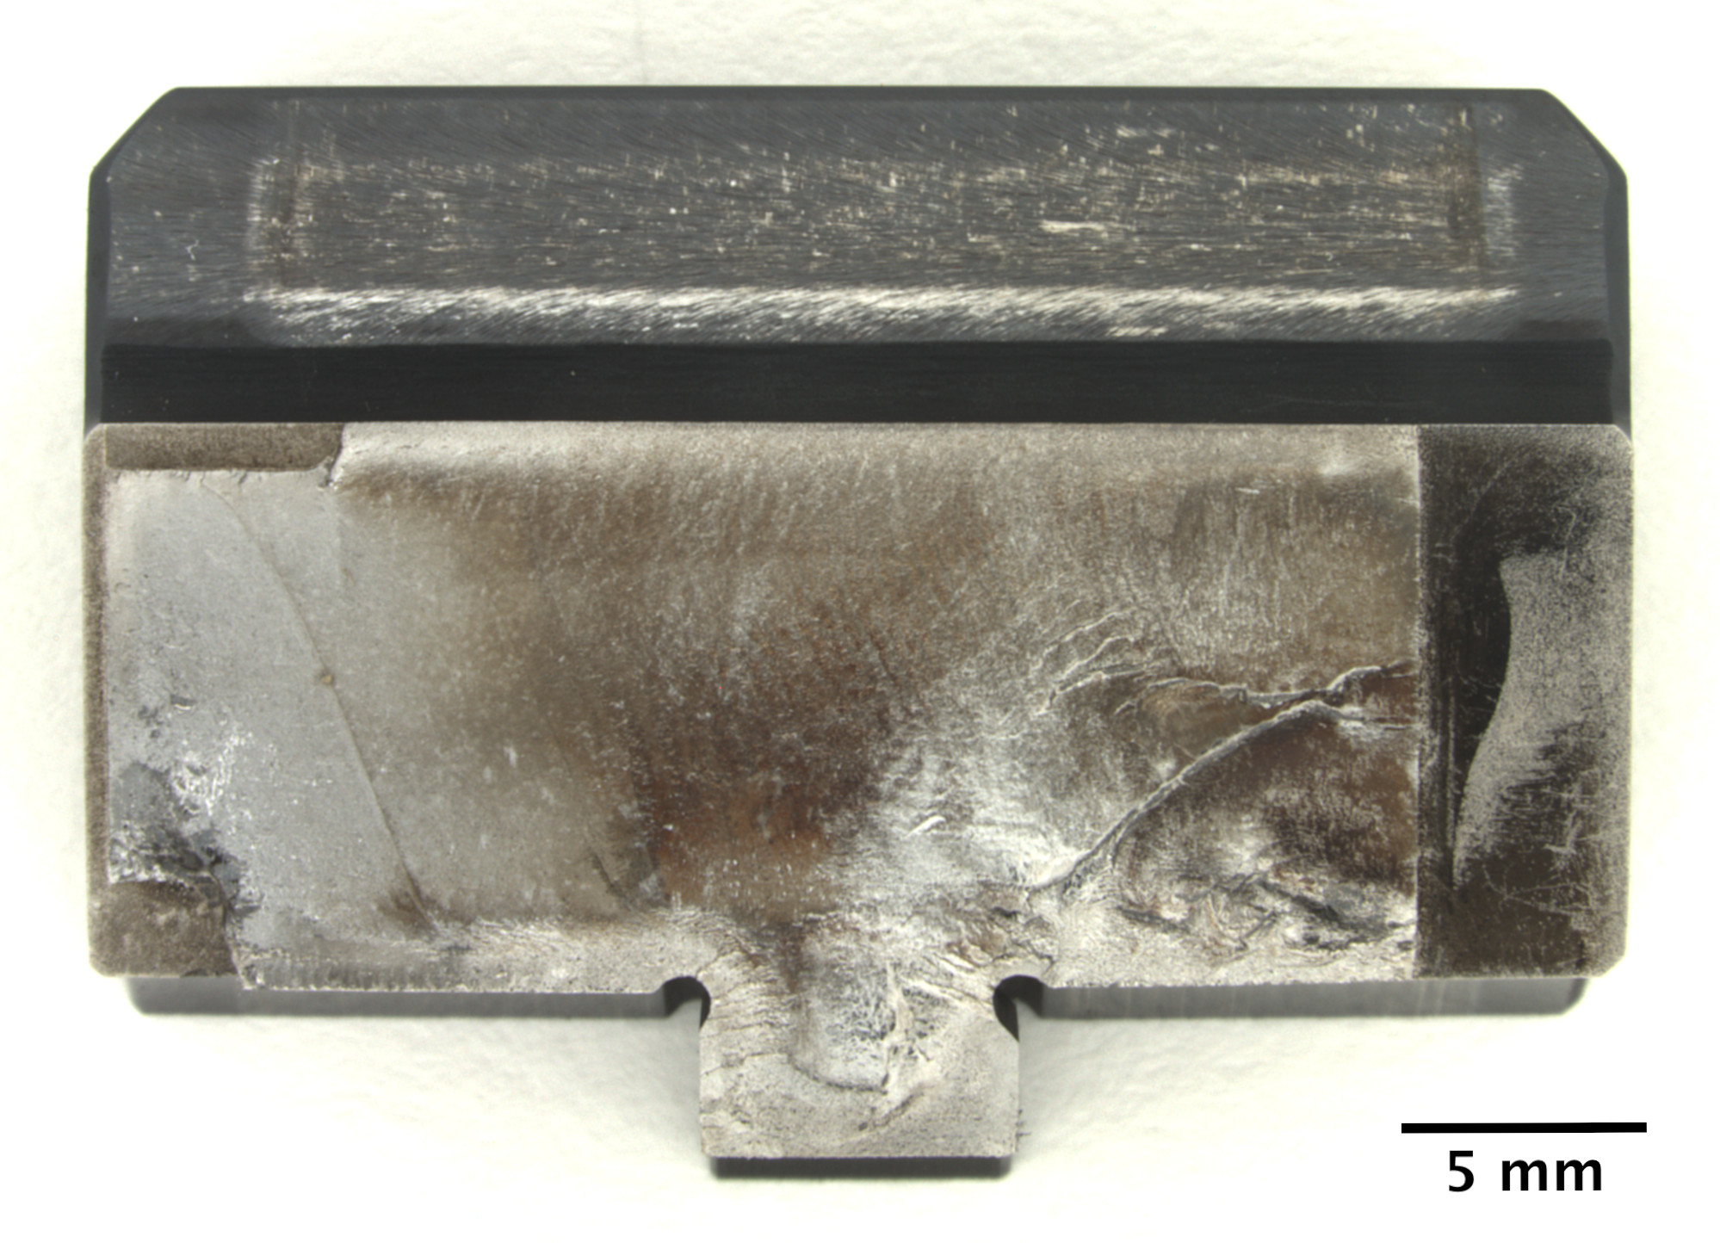
6. Summary of Fractography Analysis Report
Cycle #94 from #514
Cycle #93 from #506
Cycle #36 from #1
(1st file of the Dataset)
Last cycle #95 from file #523
Multiple origins
Multiple propagation directions initially, and merged into a dominating direction
Assumed crack initiated at Cycle #1
Cycles #1-11 by SEM, #39-54 & #57-95 by optical microscope
Rupture at Last 2 files
#525, #526
multiple initiation sites
OFFICIAL – Approved for Public Release

Slide 17
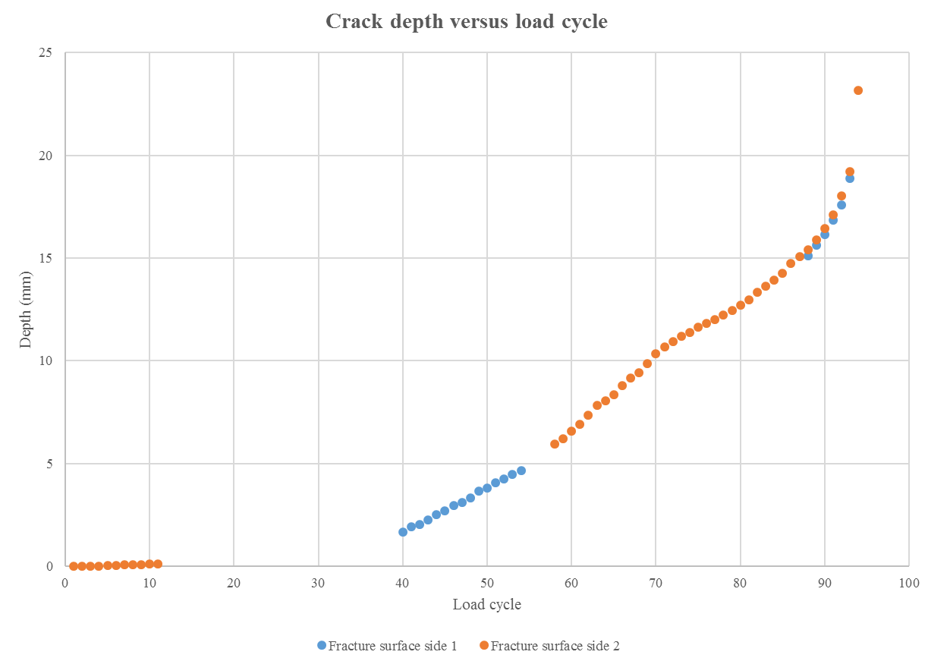
6. Summary of Fractography Analysis Report

Slide 18
6. Conclusion
Successful test – crack propagated through entire gear body
Earliest online monitoring evidence on last day of test
On line monitoring didn’t convincingly trend the crack-induced changes until the last two data files
Variations of test conditions may have created additional difficulty in fault trending
Great experience and lessons learnt
OFFICIAL – Approved for Public Release

