Slide 1
Is Traditional Approach to Detecting Gear Faults Still Working for HUMS2023 Data Challenge Problem?
Dr. Wenyi Wang and Dr. David Blunt
Platforms Division, DSTG, Australia
OFFICIAL – Approved for Public Release

Slide 2
Outline
Diagram of a traditional approach to gear fault detection
What is expected to be a convincing detection for the planet gear rim crack
Example of possible early but unconvincing detection
The earliest and more convincing detection
The fault trending curve
When the crack growth became accelerated
Summary & Conclusion
OFFICIAL – Approved for Public Release

Slide 3
1. Diagram of a traditional approach to gear fault detection
Normalization to reduce the effects of variations in speed and temperature
Hunting_SSA to 4095 x 99 array >>> Planet-SSA >>> Removing gear mesh harmonics and 2 sidebands in order domain >>> Lowpass at between 3rd and 4th gear mesh harmonics in order domain >>> Residual signals
Unlike gear tooth root crack, rim crack is more likely to generate changes at relatively low frequency range, so apply a lowpass filter – a critical step
Remove gear mesh harmonics + 2 side bands & lowpass at 3.5 x har
Normalized (0-mean,1-std) Hunting_SSA reshape to 4095 x 99 array
Real of IFFT to get residual signals
Kurtosis (detection) Scaled Kurt (trending)
Planet_SSA of 4095 long
Hilbert & FFT
OFFICIAL – Approved for Public Release
Notes:
The scaled Kurtosis = Kurtosis x RMS(i)/RMS(1) based on residual signals, so the residual kurtosis is scaled by the engine ratio of the residual signals to the 1st residual signal

Slide 4
2. What is expected to be a convincing detection for the planet gear rim crack
Planet gear rim crack characteristic feature – mesh with both ring and sun gears, so expect to see two spikes (≈180º apart) per planet gear revolution
This is different from the features of a tooth root crack where only one spike is expected as planet-ring & planet-sun meshes on diff tooth face
Consistent in most following data files after the initial detection
Confirmation in multiple channels of vibration data, and the identified features are aligned in the angle domain in those channels – residual kurtosis >= 3.5 by conventional wisdom
OFFICIAL – Approved for Public Release

Slide 5
3. Examples of possible early but unconvincing detection (#233)
Features are not aligned
OFFICIAL – Approved for Public Release

Slide 6
4. The earliest convincing detection (#264, #272, cha aligned)
Features are aligned at ~180 deg apart
OFFICIAL – Approved for Public Release

Slide 7
4. The more convincing detection (#407, #430, Kurtosis up)
OFFICIAL – Approved for Public Release

Slide 8
4. The more convincing detection (#441, #508)
OFFICIAL – Approved for Public Release

Slide 9
4. The most convincing detection (#523, #524)
OFFICIAL – Approved for Public Release

Slide 10
5. The fault trending curve (Scaled Kurtosis, 9-point MA)
Certainly accelerated, earlier?
OFFICIAL – Approved for Public Release
Notes:
Why 9-point moving average (MA)? Because there are roughly 9 files per load cycle at the 125% rated torque.

Slide 11
5. The fault trending curve (Scaled Kurtosis, 9-point MA)
OFFICIAL – Approved for Public Release

Slide 12
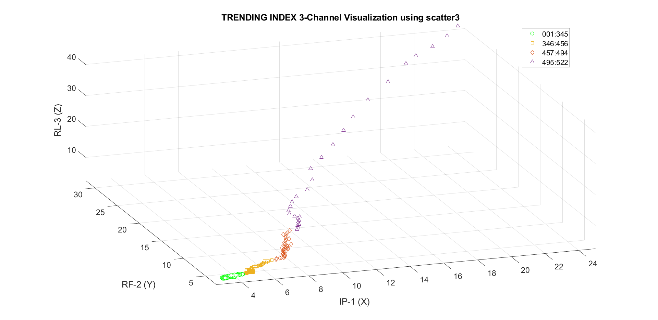
6. When the crack growth became accelerated (3D visualisation)
OFFICIAL – Approved for Public Release
Notes:
Too big the last cycle with files #523, #524, #525 and #526, so they are not shown here

Slide 13
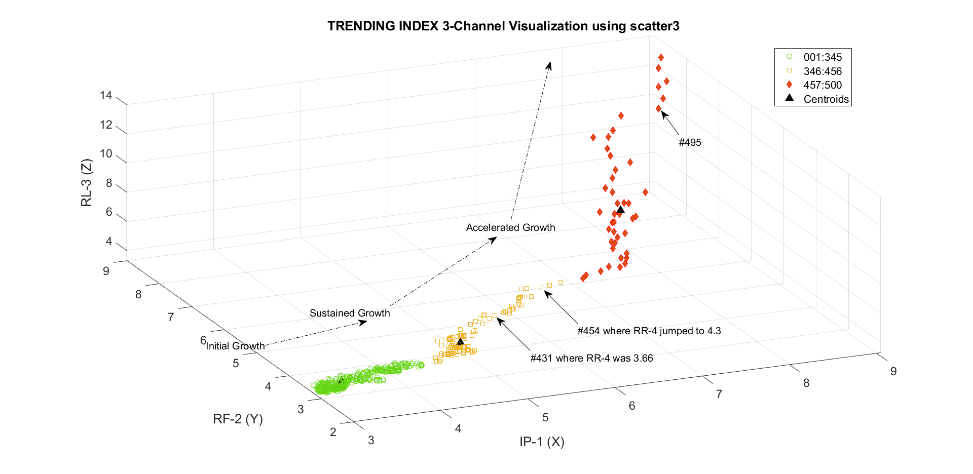
6. When the crack growth became accelerated (3D visualisation)
OFFICIAL – Approved for Public Release

Slide 14
6. When the crack growth became accelerated (clustering)
OFFICIAL – Approved for Public Release
Notes:
K-means++ algorithm for cluster center initialization with the lowest total sum of distances (city block distance metric or L1, based on the sum of absolute differences) , Silhouette (h is silent when pronouncing) value is a measure of cluster distance, which measures ranges from 1 (indicating points that are very distant from neighboring clusters) through 0 (points that are not distinctly in one cluster or another) to –1 (points that are probably assigned to the wrong cluster)

Slide 15
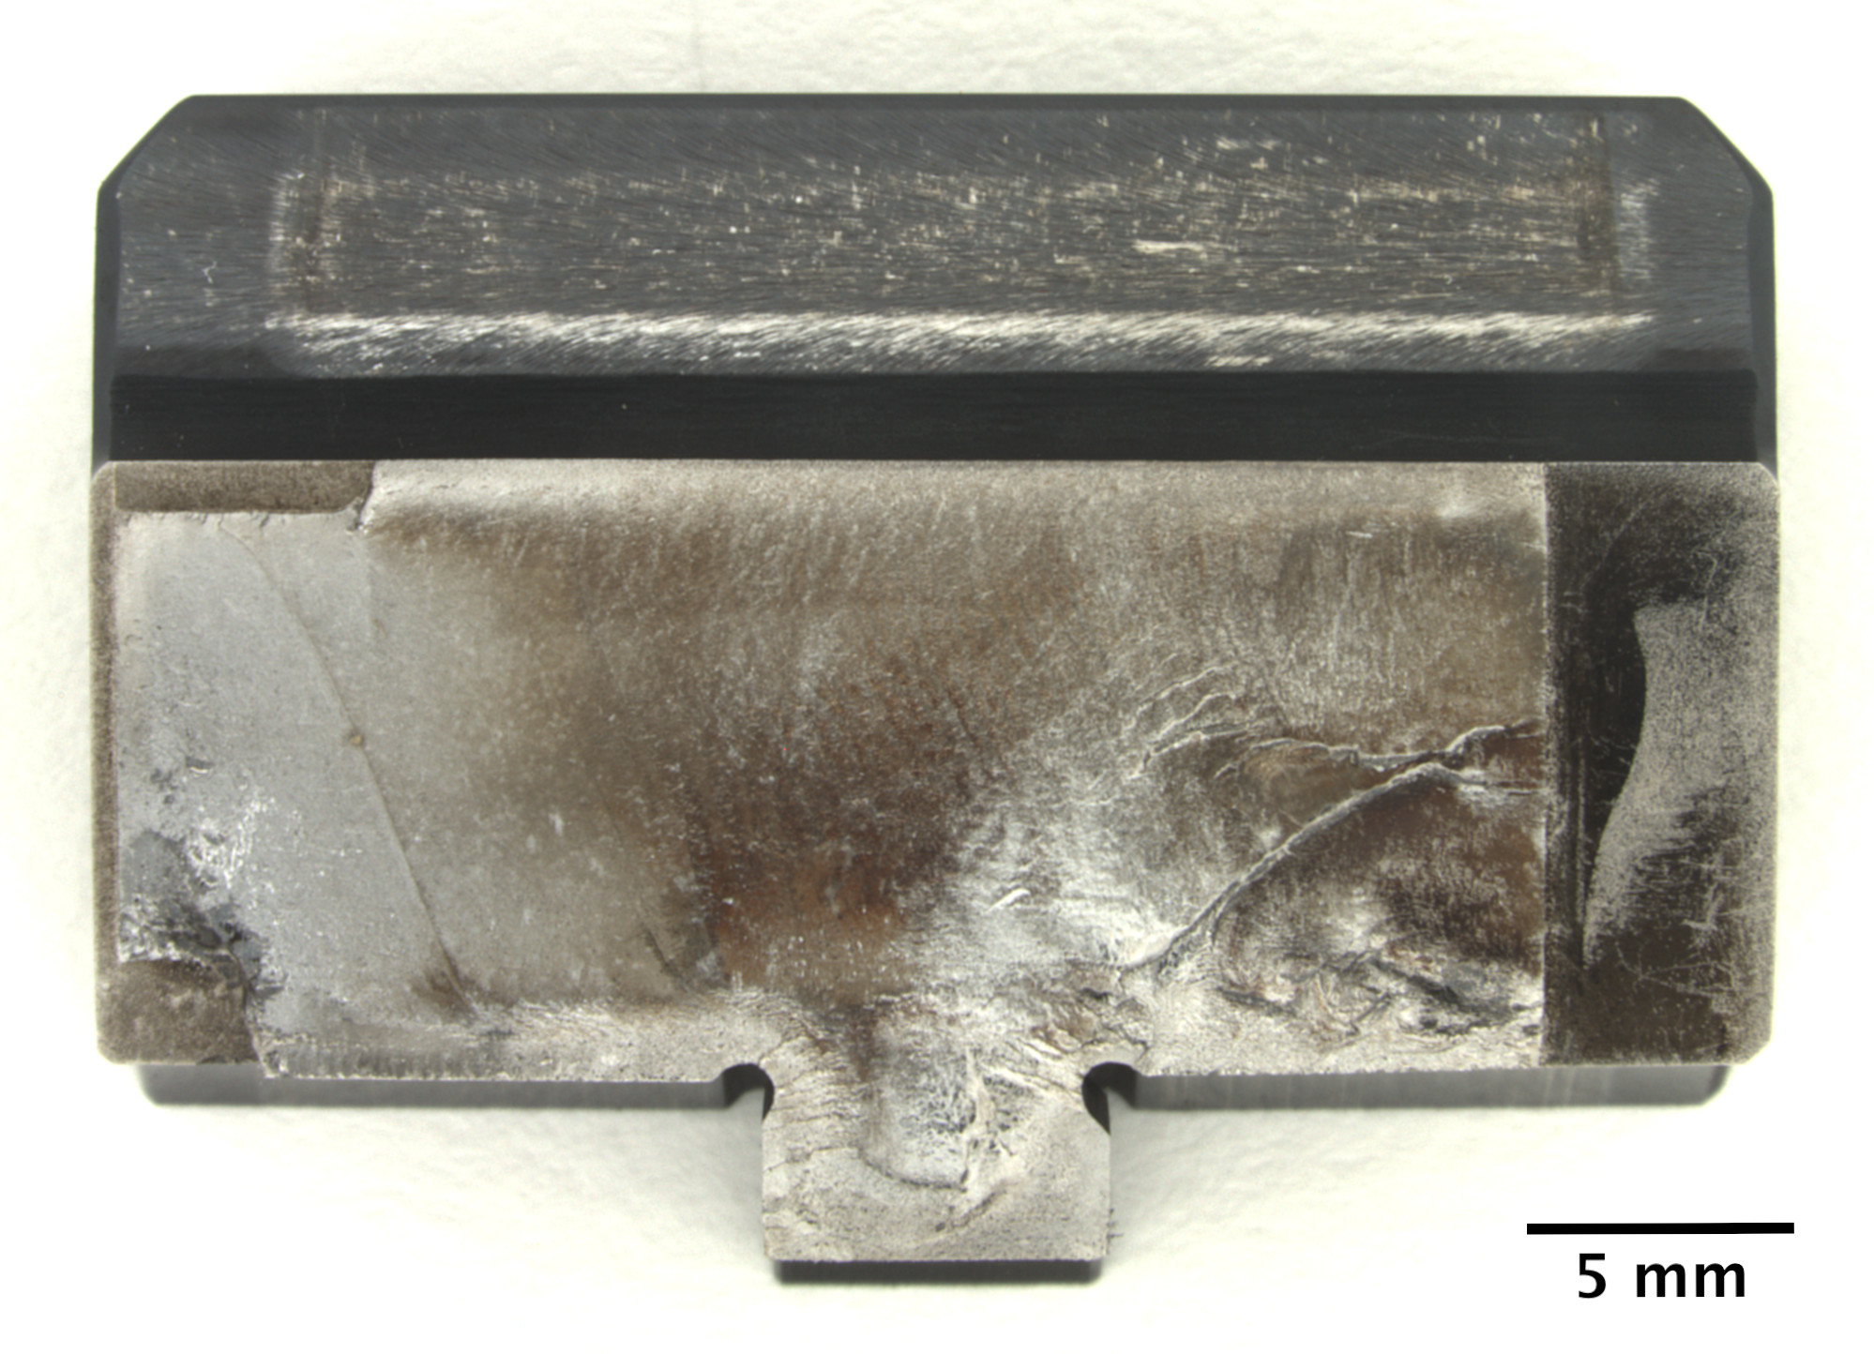
7. Summary (DSTG’s Fractography Analysis Report)
Cycle #94 from #514
Cycle #81 from #407
Cycle #65 file #264
Cycle #36 from #1
(1st file of the Dataset)
Last cycle #95 from file #523
Multiple origins
Multiple propagation directions initially, and merged into a dominating direction
Assumed crack initiated at Cycle #1
Cycles #1-11 by SEM, #39-54 & #57-95 by optical microscope
Rupture at Last 2 files
#525, #526
multiple initiation sites
OFFICIAL – Approved for Public Release

Slide 16
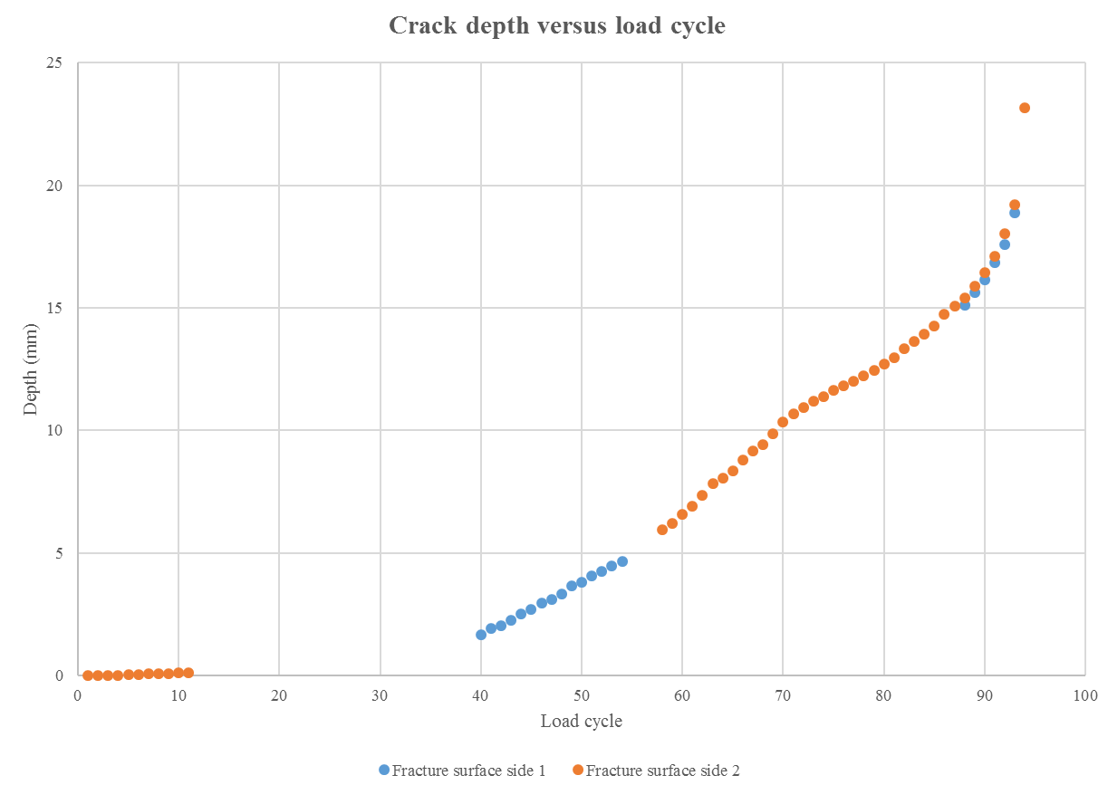
7. Conclusion – YES, the conventional method is still working
#264 (cycle #65) is the earliest convincing detection
2 channels with residual kurtosis >= 3.5
Fault features are aligned in different channels
#407 (cycle #81) is when all 4 channels have >=3.5 residual kurtosis
#457 (cycle #87) is where the accelerated growth started where K = [4.2, 3.9, 4.0, 3.9]
Accelerated growth at Cycle #87 file #457
First convincing detection at Cycle #65 file #264
OFFICIAL – Approved for Public Release

